Slide 2
Project 2010 Extensibility
Ignite World Wide Tour
Microsoft Corporation

Slide 3
Before we begin….
Are you familiar with:
Project Server 2007 Development?
Project Client Development?

Slide 4
Agenda
Extensibility overview
Project Desktop Extensibility
Overview
Considerations
Project Server Extensibility
Overview
Considerations
Resources
http://msdn.microsoft.com/project
Notes:
Broad Overview of Project 2010 Developer Investments
Project Client
Ribbon, Deprecations, 64-bit and VSTO
Project Server
Project Server Interface (PSI) enhancements
Workflows
Backwards Compatibility
Reporting
PWA Customizations
SharePoint Integration

Slide 5
Project Extensibility Overview
Project Professional/Standard 2010
Object Model, VBA, VSTO
Fluent UI, Backstage
Project Server 2010
Web Services – Project Server Interface (PSI) & Evening
Project Demand Management Workflow
Rich Reporting/Business Intelligence
Project Web Access site modifications
Theming, Fluent UI, Extensible Grid
Project and SharePoint “better together”
Project Workspaces (SharePoint Sites)
Any other customizations/add-ons leveraging any of the SharePoint Enterprise Suite
More http://msdn.microsoft.com/project/

Slide 6
Project Desktop 2010 Extensibility
Ignite World Wide Tour
Microsoft Corporation

Slide 7
Project Professional 2010 Project Standard 2010

Slide 8
Agenda
Overview
Ribbon Programmability
Continued Support for VBA
Task Panes
VSTO Support
Managed Code in the Client

Slide 9
Project 2010 “desktop” extensibility WITHOUT code
“Custom Fields”
Custom metadata associated with tasks, resources, assignments and (projects)
Could have an icon representation and formulas
Views Modification
Adding columns, custom grouping and filtering, e.g. based on the Custom Fields
Custom Visual Reports
Manage your custom templates for Excel and Visio – based reporting

Slide 10
Project 2010 “desktop” extensibility WITH code
Desktop Object Model (OM)
Rich customizations and add-ons leveraging Project functionality including scheduling
Visual Basic for Applications (VBA) or Visual Studio Tools for Office (VSTO) could be used
User Interface (UI) modifications
Ribbon
Backstage

Slide 11
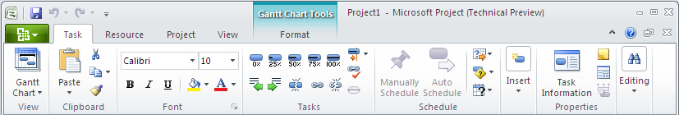
Ribbon Customization
Replaces the current system of layered menus and toolbars
Legacy code will continue to work in most cases without modification
Customizations made to toolbars now appear on an Add-Ins tab
Ribbon Extensibility (RibbonX)
Same XML schema as other Office Applications
SetCustomUI Property
Ribbon Designer will not be supported for Project 2010

Slide 12

Ribbon Customization Customizing the Ribbon Highlight Manual Tasks
demo

Slide 13
Client Deprecations (1 of 3)
Project Guide
Only the Content
Infrastructure will continue to exist
3rd parties will continue to be able to use the infrastructure
Configuration will be via the OM and not the UI
Project 2007 Project Guide content will ship in the Project 2010 SDK
Content will not be updated for Project 2010

Slide 14
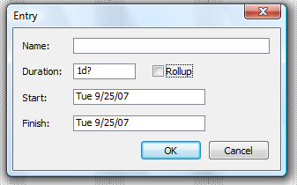
Client Deprecations (2 of 3)
Custom Forms
Allowed Developers to quickly create Win32 forms to display project data
Out of Box Forms will be Deprecated
Cost Tracking
Earned Value
Entry
PERT Entry
Schedule Tracking
Task Relationship
Work Tracking

Slide 15
Client Deprecations (3 of 3)
Toolbar and Dialog Form OM Methods and Properties
New Ribbon Design is reflected in the OM

Slide 16
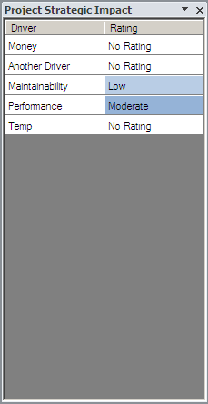
Task Panes
Office 2007 added Support for Custom Task Panes
Project’s implementation is the same
Provides a panel in the Project Client interface
Familiar User Interface
Windows Forms Support
Application Specific
Not Document Level
Notes:
Familiar User Interface
Users of applications in the Microsoft Office system are already familiar with using task panes such as the Styles and Formatting task pane in Word. Custom task panes behave like other task panes in the Microsoft Office system. Users can dock custom task panes to different sides of the application window, or they can drag custom task panes to any location in the window. You can create an add-in that displays multiple custom task panes at the same time, and users can control each task pane individually.
Windows Forms Support
The user interface of a custom task pane that you create by using Visual Studio Tools for Office is based on Windows Forms controls. You can use the familiar Windows Forms Designer to design the user interface for a custom task pane. You can also use the data binding support in Windows Forms to bind a data source to controls on the task pane.

Slide 17
Project Desktop 2010 Available in 32 and 64 bit
Project Client 2010 will be delivered as:
Native 32-bit Applications (As Before)
Native 64-bit Applications (New!)
32-bit Highly Compatible
As usual, high degree of compatibility with solutions built on previous versions of Project
Data Execution Prevention (DEP), new for Office 2010, may require some changes (but can be opted-out)
64-bit Humongous Capacity
Some power users with want or need 64-bit (for example: customers with very, very large projects)
Some compatibility challenges…
Default install is 32-bit, even on 64-bit Windows
32-bit and 64-bit can not be installed on the same box

Slide 18
What will you need to do?
32-bit COM Objects can not be directly used in 64-bit applications
Recompile 64-bit version
Declare Functions will have to be updated for their 64-bit versions
Wrap new Declare in “#If Win64”
Data Execution Protection (DEP)
Notes:
Port to 64-bit required:
- Source code is in house, recompile for 64-bit
- Vendor provides a new 64-bit version
- Switch to an alternative that is available on 64-bit
Declare Functions will need to be updated:
- We ship WIN32API.TXT which contains 1,500 Declare statements, translated from windows.h
- We will ship a tool to cut and paste the Declare you need into your code
- Why: Unpredictable and crashing behavior results if a 64-bit pointer is truncated when placed in a 32-bit Long variable
Compatibility:
O12 use “#If VBA7”
O11 use else case
Data Execution Protection (DEP)
- Prevents code from running in the data portion of process memory
- Security Feature, prevents viruses from running their own code within a process
- Somewhat rare, but was sometimes done for performance
For offending Add-ins, can it be disabled?
- On by default for 32-bit, but can be turned off
- On permanently for 64-bit

Slide 19
What is VSTO?
VSTO stands for Visual Studio Tools for Office
Enables developers to create managed code solutions in Office applications
Visual Studio 2008
Project 2003 and Project 2007
Visual Studio 2010
Adds support for Project 2010

Slide 20
Benefits and Limitations of VSTO
Benefits
.Net Framework
Limitations
Enterprise Global
Develop in Visual Studio
Project Server Interface
Development Tools
Managed Code
Notes:
Code that is managed by the .NET Framework and includes automatic garbage collection
Access to thousands of classes in the .NET Framework class library
Simple to connect to the Project Server Interface (PSI)
Use of an object-oriented programming language
Improved security model
More manageable update and rollback model
Better environment and debugging tools
Enhanced object models that enable data binding and expose events on native Office objects
Stable loading of managed add-ins

Slide 21
Getting Started
Tools:
Visual Studio 2008 and Greater
Project Client 2003 and Greater
Skills:
.Net Development (C#, VB)
Project Client Programmability (VBA)

Slide 22
Visual Studio Tools for Office Getting Started
demo
Notes:
Open VS and create new Project 2007 Add-in
Point to WinProj.exe
Project → NAME Properties…
Debug
Start external program:
Build Solution
Run the VSTO Installer
“Hello World” example
using System.Windows.Forms;
MessageBox.Show("Hello World");
Show how to manage the Add-In from the Backstage

Slide 23
Project Desktop 2010 Development Resources
Project Developer Center
http://msdn.microsoft.com/project
Project “Programmability” blog
http://blogs.msdn.com/project_programmability
Extend The 2007 Office System With Your Own Ribbon Tabs And Controls
Creating Custom Task Panes in the 2007 Office System

Slide 24
Project Server Extensibility Overview
Ignite World Wide Tour
Microsoft Corporation

Slide 25
Agenda
Project Server Extensibility Overview
Impersonation
Status Broker
Departments

Slide 26
Project Server Extensibility
Project 2003
Project 2007
Project 2010
Notes:
Project 2003
Project Data Service (PDS)
Server side API
XML based
PDS Extensions
SQL Triggers required to implement business logic extensions
Project Professional required for scheduling projects
Project Professional direct database connection
Project 2007
Great Extensibility / Development platform
Extensive
Anything you can do in PWA, you can do through custom code
Improve developer productivity
.Net Technology
Consistency
Firewall friendly
Project Server 2010 builds on these Goals

Slide 27
Project Server 2003 Developer Experience
Project Data Service (PDS)
Server side API
XML based
PDS Extensions
SQL Triggers required to implement business logic extensions
Project Professional required for scheduling projects
Project Professional direct database connection

Slide 28
Project Server 2007 Developer Experience
Goals
Great Extensibility / Development platform
Extensive
Anything you can do in PWA, you can do through custom code
Improve developer productivity
.Net Technology
Consistency
Firewall friendly
Project Server 2010 builds on these Goals

Slide 29
Project Server Events
New feature in Project 2007
Raised on the server
3rd party applications “subscribe” to events
“Hooks” for
Adding new functionality
Customizing exiting functionality
Integrating with other applications

Slide 30
Project Server Event Types
Pre events:
Before the data is saved to the database
Cancelable
Synchronous
Post events:
After the data has been saved to the database
Non-cancelable
Asynchronous or synchronous
Notes:
Pre events:
Constraints
Custom data validation
Business rule checks
Post events:
LOB integration
Post save data transformation/synchronization

Slide 31
How Project Server Events Work
Resource Check Event Handler
Create Resource
Events Service
Resource Check Event Handler
Events PSI
Resource PSI
Content Database
Resource Check Event Handler
Notes:
- Implemented as managed code
- .NET Framework 2.0
- Need to be deployed to each middle tier machine in the farm
- Must be strongly signed (security requirement)
Each event can have multiple event handlers associated with it.
Specify execution order

Slide 32
Project Server extensibility – what’s new in 2010

Slide 33
Project Server Architecture Overview
3rd Party Application
Project Professional
IE
WCF Forwarder
Web Service
Forwarder
Project Web Access
WSS and
MSS
3rd Party Application
WFE
Web Services
WCF Service
WSS and
MSS
Events
Business Objects
Queue
App Server
Data Access Layer (DAL)
MS SQL
Draft
Publish
Reporting
Archive
Content
Config

Slide 34

Project Server 2010 Interface
Admin
Object Link Provider
WSS Interop
Archive
Project
Driver
Calendar
Queue
Portfolio Analysis
Cube Admin
Resource
Workflow
Custom Fields
Resource Plan
Events
Security
Lookup Table
Statusing
Notifications
Timesheet

Slide 35
Impersonation (ENHANCED) and Status Broker (NEW)

Slide 36
Impersonation
Allows a super user to act on the behalf of another user
Why use Impersonation?
Need to adopt the global and category permissions of another user
Statusing in Project Server 2007
Elevate Permissions for a Specific Job
Create, Update and Delete entities on the behalf of other Users

Slide 37




Impersonation with Project Server 2007
Web Frontend
Application Server
PWA
Web Services
Business Objects
Context
Customer Application
Web
Service
Forwarder
Context
Custom LOB Application
Context

Slide 38
Impersonation with Project Server 2010
Application
Server
WCF Services
Web Frontend
Web Services
Business Objects
PWA
Custom LOB Application
WCF Forwarder
Context
Web Service Forwarder
Notes:
Create an account with a special permission
Available after Beta 2

Slide 39
Status Broker in Project 2010
Project Server
External System
Notes:
Project Server 2007
Impersonation Required for LOB Applications working with Statusing
Huge Performance Cost
Project Server 2010
Eliminates the need to Impersonate
Introduces the concept of Status Broker

Slide 40
Status Broker in Project 2010
New Global Permission in the Time and Task Management group
The following 3 methods were extended
ReadStatusForResource(…)
UpdateStatus(…)
SubmitStatusForResource(…)
Additional parameter for specifying the ResID
<Changes>
<Proj ID='c98af47e-c800-4826-b9f5-2e1d84a41855'>
<Assn ID='8b4e7966-f42e-4f08-9758-532e6e087e22'
ResID='8b36b53d-780c-4c53-9f4c-8996108ff40d'>
<Change PID='251658274'>10</Change>
</Assn>
</Proj>
</Changes>

Slide 41
Status Broker Status Update
demo
Notes:
Show how to setup status Broker
Run sample app
Log in as user

Slide 42


Departments
PWA Instance
Legal
Finance
Marketing
Notes:
GOALS
* Support Enterprise Custom Fields (Project, Task, and Resource) per department
* Filter out, where appropriate, custom fields which aren’t relevant to a Project or resource
* Prevent users having to Namespace CFs
* Not providing delegation of custom field creation
* Prevent editing of CFs that aren’t in a Project’s department

Slide 43
Departments
Leverages the Custom Field Infrastructure
Out of the box Custom Fields and Lookup Tables
Project Custom Field: Project Department
Resource Custom Field: Resource Department
Lookup Table: Departments
Custom Field
Lookup Table
Notes:
Custom Fields
Project Departments
Resource Departments
Lookup Table
Departments

Slide 44
Departments
Added to a number of Data Tables:
Project
Resource
Portfolio Analyses
Drivers
Prioritizations
Cubes

Slide 45


Department PSI Methods
Resource
ReadResourceListByDepartment(…)
Project
ReadProjectListByDepartment(…)
Admin
ReadDepartments(…)
ReadDepartmentsByEntity(…)

Slide 46
Project Server Developer Overview Resources
Project Developer Center
http://msdn.microsoft.com/project
Project “Programmability” blog
http://blogs.msdn.com/project_programmability
Project 2007 SDK
Project 2010 SDK

Slide 47
Backwards Compatibility
Ignite World Wide Tour
Microsoft Corporation

Slide 48
Agenda
Writing applications that work against Project Server 2007, Project Server 2010 and beyond
Backwards Compatibility Mode
BCM vs. Native mode with respect to the PSI

Slide 49
Writing Applications with Backwards Compatibility in Mind
Make use of the Typed Datasets
Do not index directly into a dataset
Use the constants in Microsoft.Office.Project.Server.Library.DLL
Do not assume the width of a data table or the number of data tables
Handle any error that comes at you

Slide 50
PSI Method Deprecation
PSI naming convention for changed methods:
Project 2007:
UpdateCustomFields(…)
Project 2010:
UpdateCustomFields(…)
UpdateCustomFields2(…)
Deprecated methods will be marked in the SDK and removed from the product in Project 16

Slide 51
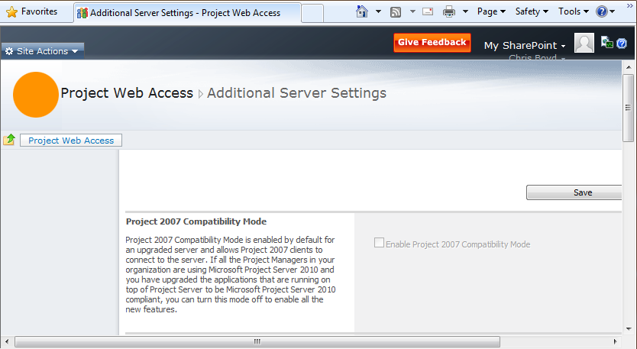
Backwards Compatibility Mode
BCM Mode
Applications should work without being recompiled
If not, LET US KNOW!
Native Mode
Most Applications should work without needing to be recompiled

Slide 52
Show Upcoming Tasks BCM vs. Native
demo

Slide 53
Project Server Developer Overview Resources
Project Developer Center
http://msdn.microsoft.com/project
Project “Programmability” blog
http://blogs.msdn.com/project_programmability
Project 2007 SDK
Project 2010 SDK

Slide 54
Customizing the Demand Management Experience
Ignite World Wide Tour
Microsoft Corporation

Slide 55
Agenda
Brief overview of demand management
Explore the new Project Server Interfaces (PSIs) for Demand Management
Drivers, Portfolio
Workflow

Slide 56
Demand Management and Project Selection Overview
Project Plan
Project Plan
Project Plan
Selected Project Plans
Notes:
- Original Feature List
- DCR Plans

Slide 57

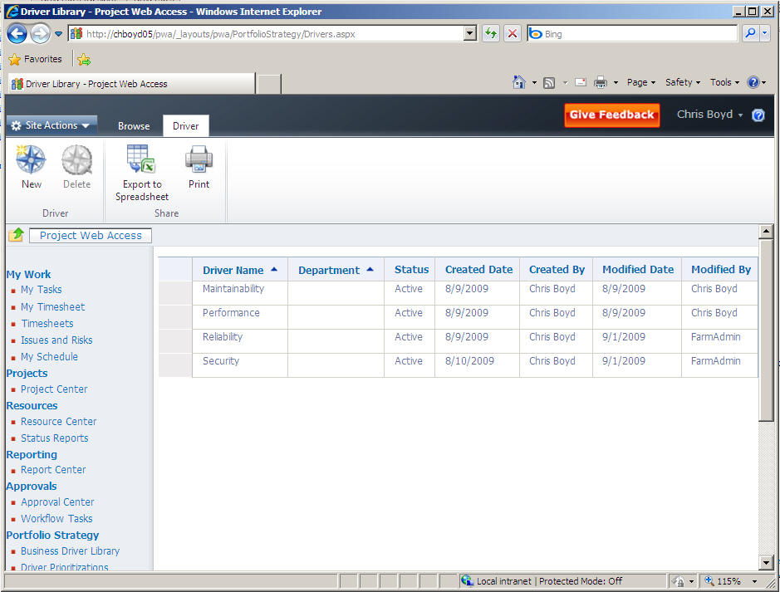
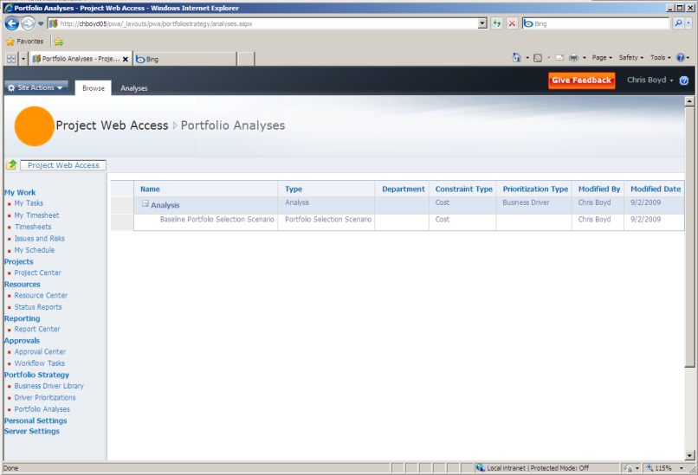
Project Server 2010 Interface
Allows the creation, manipulation and deletion of optimizations and plans
Read existing solutions
Allows the creation, manipulation and deletion of dependencies
Admin
Allows for creation, manipulation deletion of business drivers and business driver prioritizations
For project prioritizations, use the Project Impact methods found in the Project PSI
Object Link Provider
WSS Interop
Archive
Project
Driver
Calendar
Queue
Portfolio Analysis
Cube Admin
Resource
Workflow
Custom Fields
Resource Plan
Events
Security
Lookup Table
Statusing
Notifications
Timesheet
Notes:
- Business Driver PSI will be shown off in my VSTO demo

Slide 58



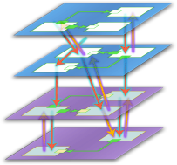







Project Workflow Overview
Allows for custom project selection process
Custom Workflows created in VS2010
No Support for SharePoint Designer (SPD)
Enterprise Project Management
Create
Select
Plan
Manage
Demand Management
Portfolio Selection
Work Planning
Collaboration & Reporting

Slide 59
Project Workflow Architecture
Project Workflows
Project Server 2010
Windows SharePoint Service
Windows Workflow Foundation
.NET Framework 3.5
Notes:
Workflow is a big piece, unlike the other web methods workflow is running underneath the hood all the time. Plus your hear for SharePoint so we might as well discuss it

Slide 60

Terminology
Enterprise Project Type
Workflow
Create
Select
Propose
Review
Select
Execute
Cancel
Cancel
Notes:
How are these different from Project Types?
- Workflow: Single workflow per EPT
- Phases represent a collection of stages grouped together to identify a common set of activities in the project life cycle
- Stage represents a single step in the process

Slide 61
Terminology
Enterprise
Project Type
Workflow
Propose
Create
Project Detail Page
Custom Field 1:
Propose
Review
Custom Field 2:
Cancel
Custom Field 3:
Notes:
How are these different from Project Types?
- Project Detail Page (PDP): A page in PWA with a set of Web Parts. Out of the box, we display custom fields in the web part. We also include the schedule web part on the PDP page
A stage in Project Server is also a stage in Visual Studio
Custom Fields are compared in in the workflow

Slide 62
Project Server Workflow Breakdown
Project Server Interface
Project Server Workflow Channel
Custom Activity
Custom Activity
Custom Activity
Notes:
Those who have done extensive sharepoint workflows will be familiar with terms like Activities, and Channels. And those who have developed against Project Server in the past will have heard of our PSIs.
But for the rest of us, we may not be as familiar with all this. So how does it start?
We started with our PSIs. Our PSIs are nothing more than APIs we have crated and exposed to our customer to create custom code against. In fact, much of Project Server itself uses these public PSIs
Now, Project Server Worfklows, like Sharepoint Workflows, is composed of different activities.
Now Sharepoint and MOSS have already created a lot of different activates of which we are taking advantage of. In addition, Project Server comes with several Out of the Box activities which are specific to Project Server.
These activities will then reference our custom Channel, and then our channel, will then reference our PSIs.
This of the channel as another API layer. All of the PSI calls, the security handling, is done within the channel. The activities, just call the public functions within the channel.

Slide 63










Out of Box Workflow Activities
OnProjectCheckin
CompareProjectProperty
OnProjectCommit
OnProjectSubmit
ProjectSequence
ReadProjectProperty
ReadProjectSecurityGroupMembers
SetProjectStage
UpdateProjectProperty
UpdateProjectStageStatus
Notes:
CompareProjectProperty
An Activity that will compare the value of a project Custom or intrinsic Field and return True/False
OnProjectCheckin
An Activity that will pause the workflow until a Project Checkin Event happens for the current project
OnProjectCommit
An Activity that will pause the workflow until a Project Commit Event happens for the current project
OnProjectSubmit
An Activity that will pause the workflow until a Project Submit Event happens for the current project
ProjectSequence
A wrapper activity that must be the second activity in the workflow (right after onWorkflowActivated). All following activities must be placed within this activity and will need to inherit the workflow context.
ReadProjectProperty
An activity that will return the value of a Project Custom or intrinsic field
ReadProjectSecurityGroupMembers
An activity that will return all of the members of a particular security group within Project Server, with or without filtering based on department.
SetProjectStage
This activity defines when a stage starts. Stages that are created within Project Server are referenced directly using this activity
UpdateProjectProperty
An activity used to update an intrinsic or custom field
UpdateProjectStageStatus
Updates the status message for a stage.

Slide 64
Developing a Workflow
Development
Create in Visual Studio
Deployment
Associate with an Enterprise Project Type
Debug
Create a project by Selecting a Project Type
Design using Project Related Activities
Compile
Define PDPs, Phases and Stages
GAC the DLL
SharePoint workflow starts
User adds project information with PWA
Notes:
Visual Studio Only (No SharePoint Designer)
Shipping OOB Project Activities
Shipping Sample Workflow as part of the SDK
Enterprise Project Type Associations

Slide 65
Workflow PSI
Trigger workflow actions and validations
Create, modify and delete workflow entities
Enterprise Project Templates, Phases and Stages
Get and Set the Workflow Proxy User

Slide 66
Simple Project Selection Workflow
demo

Slide 67
Project Server Developer Overview Resources
Project Developer Center
http://msdn.microsoft.com/project
Project “Programmability” blog
http://blogs.msdn.com/project_programmability
Project 2010 SDK
Workflow and Demand Management
Scenarios for Project Server Development
Developing Project Server Workflows

Slide 68
Project Web Access Customization
Ignite World Wide Tour
Microsoft Corporation

Slide 69
Agenda
Adding JavaScript to a PWA Page
Server Ribbon Customization
JavaScript Grid Control

Slide 70
Adding JavaScript
Project 2007 involved hacking the page
Upgrade issues
With a “Custom Action”, JavaScript can be added to a PWA page
Scoped at the SharePoint Site

Slide 71
Feature XML
<Feature Title="Simple Block of JavaScript"
Scope="Web"
Id="GUID"
xmlns="http://schemas.microsoft.com/sharepoint/">
<ElementManifests>
<ElementManifest Location="Elements.xml" />
</ElementManifests>
</Feature>

Slide 72
Elements XML
<Elements xmlns="http://schemas.microsoft.com/sharepoint/">
<CustomAction
Id="SimpleBlockJavaScript.AdditionalScript"
Location="ScriptLink"
ScriptBlock="alert ('Hello World!');"
/>
</Elements>

Slide 73
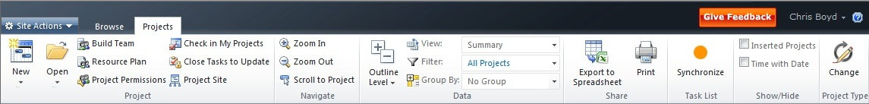
Server Ribbon Extensibility
Customize the Server Ribbon
Create and Activate a Feature
Create, Modify and Hide
Tabs
Groups
Buttons
Actions call JavaScript Event Handlers
Create and Activate a Feature

Slide 74
JavaScript to a PWA Page Custom Ribbon
demo
Notes:
Create a SimpleBlockJavaScript folder in Local_Drive:\Program Files\Common Files\Microsoft Shared\web server extensions\14\TEMPLATE\FEATURES.
In this folder, create a Feature.xml file with the following content, which uses the Feature element to register the Feature.
<Feature Title="Simple Block of JavaScript"
Scope="Web"
Id="GUID"
xmlns="http://schemas.microsoft.com/sharepoint/">
<ElementManifests>
<ElementManifest Location="Elements.xml" />
</ElementManifests>
</Feature>
Generate a new GUID to replace the GUID placeholder in the previous Id attribute.
Create an Elements.xml file in the SimpleBlockJavaScript folder that contains the block of JavaScript, such as the following, which uses the CustomAction element to define the custom action.
<Elements xmlns="http://schemas.microsoft.com/sharepoint/">
<CustomAction Id="SimpleBlockJavaScript.AdditionalScript"
Location="ScriptLink"
ScriptBlock="alert ('Hello World!');"
/>
</Elements>
At a command prompt, type the following commands to install the Feature in the deployment, and then activate the Feature on a specified subsite.
stsadm -o installfeature -filename SimpleBlockJavaScript\Feature.xml
stsadm -o activatefeature -filename SimpleBlockJavaScript\Feature.xml -url http://Server/Site/Subsite
To try out the JavaScript, navigate to the site and see the “Hello World!” alert.

Slide 75
Project Server Developer Overview Resources
Project Developer Center
http://msdn.microsoft.com/project
Project “Programmability” blog
http://blogs.msdn.com/project_programmability

Slide 76
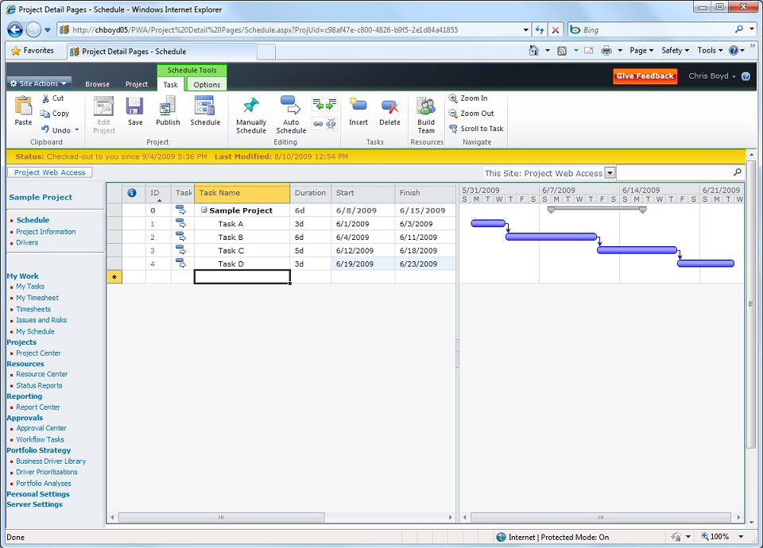
New Grid Control
Notes:
Change Key API, server can respond with “effects of the change”

Slide 77
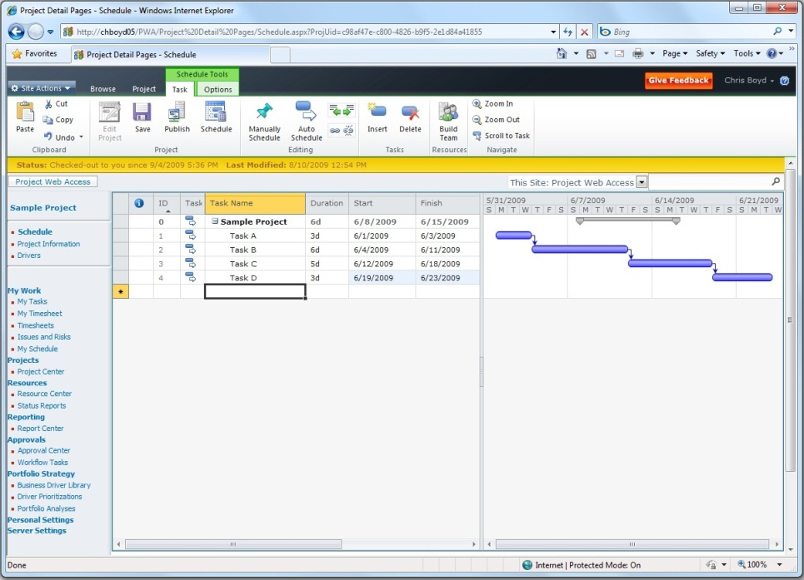
New Grid Control
JavaScript (Not ActiveX)
Multi-Browser Support
IE7, IE8, Firefox, Safari (tier 2)
PWA only supports IE7 and IE8
Ships with SharePoint
Feature Rich:
Copy and Paste (from Excel and others)
Multi-Level Undo
Change Highlighting
Cell Level Errors
Time-phased or Pivoted View
Dynamic Paging
Notes:
JSON or XML, you choose how you want to send over the data
C sharp interface for data binding (like to a SharePoint list)
JavaScript interface for more complex behaviors

Slide 78
Grid Control Programmability
On-screen paging
Built-in text edit control at the cell level
Cell addressability
Get and set cell positioning
Column reordering
Status indicator that enables feedback about current actions to be provided to the user

Slide 79
Grid Control Programmability
Multiple undo/redo back to the original point of change
Optional change highlighting, equivalent to change highlighting in Project 2010 Professional
Programmatically disable cells from being edited

Slide 80
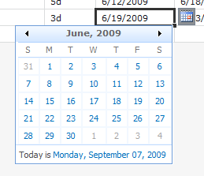
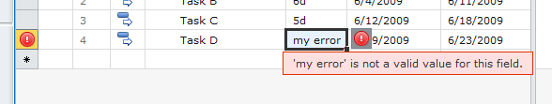
“Widget” and “Display Control”
Notes:
Play around with it in SharePoint

Slide 81
Project Server Developer Overview Resources
Project Developer Center
http://msdn.microsoft.com/project
Project “Programmability” blog
http://blogs.msdn.com/project_programmability
Project 2010 SDK

Slide 82
Reporting
Ignite World Wide Tour
Microsoft Corporation

Slide 83
Agenda
Project 2010 Reporting Database
Considering the RDB as a development interface
PSI Extensions
Events
Tour of the RDB
Sample Timesheet Query

Slide 84
Project 2010 Reporting Database
Existing Project 2007 Reports should continue to work in Project 2010
Timesheet Custom Fields
Change based on PWA View
Project Properties
Workflow
Minus the Notes Field
Departments
Multi Cube based on Department

Slide 85
Using the RDB to Extend the PSI
Optimized datasets for your application
Performance Benefits
More data available to the developer
Baseline, Time Phased, etc…
Seamless Integration with the PSI
Great way to make RDB data accessible securely and firewall safe
Walkthrough: Creating a PSI Extension

Slide 86
Using RDB Events
Events let you react to change
Event code is Synchronize
Minimize the time spent in event handler
Use async code if appropriate
Data coherency
Latency considerations
RDS is multi-server/multithreaded

Slide 87
ASynchronize Behavior
All RDB operations are queued
Code has no UI
Developer must implement a mechanism to send errors to the user or admin
Data can arrive in parallel (multi-threaded) from multiple servers (multi-process)
Design your code to avoid deadlocks and minimize blocking
Data will show in PWA before it arrives in RDB

Slide 88
Security Considerations
RDB does not restrict data access
To Secure Objects:
Call back into the PSI with the original caller’s context
Implement your own access control
Custom Field with event enforcement is a great option

Slide 89
Timesheet Custom Fields Reporting
demo

Slide 90
Reporting Development Resources
Walkthrough: Creating a PSI Extension
Project 2010 SDK
Schema Reference

Slide 91
SharePoint Integration
Ignite World Wide Tour
Microsoft Corporation

Slide 92
What’s in for me?
SharePoint Integration with Visual Studio 2010
Web Part Creation
Developer Dashboard
Line of Business Integration
Business Connectivity Services

Slide 93
SharePoint Integration Development Resources
SharePoint 2010 Developer Sneak Peak
SharePoint Developer
SharePoint 2010 Conference

Slide 94
Project Developer Overview Resources
Project Developer Center
http://msdn.microsoft.com/project
Project “Programmability” blog
http://blogs.msdn.com/project_programmability

Slide 95
Questions?

Slide 96

© 2009 Microsoft Corporation. All rights reserved. Microsoft, Windows, Windows Vista and other product names are or may be registered trademarks and/or trademarks in the U.S. and/or other countries.
The information herein is for informational purposes only and represents the current view of Microsoft Corporation as of the date of this presentation. Because Microsoft must respond to changing market conditions, it should not be interpreted to be a commitment on the part of Microsoft, and Microsoft cannot guarantee the accuracy of any information provided after the date of this presentation. MICROSOFT MAKES NO WARRANTIES, EXPRESS, IMPLIED OR STATUTORY, AS TO THE INFORMATION IN THIS PRESENTATION.

